Slide 1
Digital Forensics Presentation
Ezra Ho, Ryan Ng

Slide 2
Table of Contents
Autopsy
Plaso (Log2Timeline Backend)

Slide 3
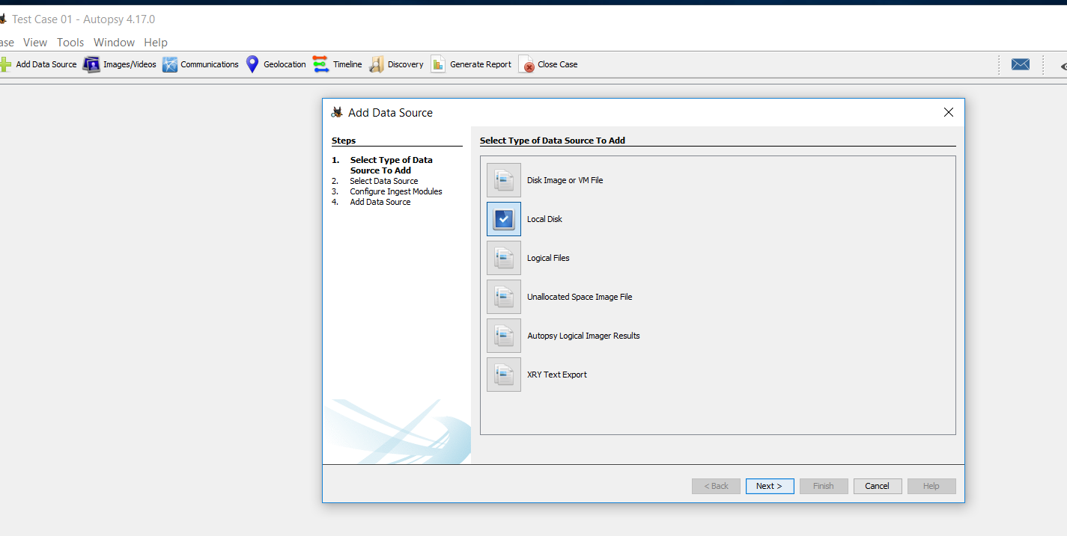
Autopsy – Ingest Module
This shows the start of the Ingest Module process.
They can import from a variety of mediums such as Disk Images, VM Files, Logical Files, Unallocated Space Files and Autopsy Imager Results.
Many other evidence file formats and filesystem architectures are also supported.
Notes:
This shows the start of the Ingest Module process. They can import from a variety of mediums such as Disk Images. Many other evidence file formats and filesystem architectures are also supported.

Slide 4
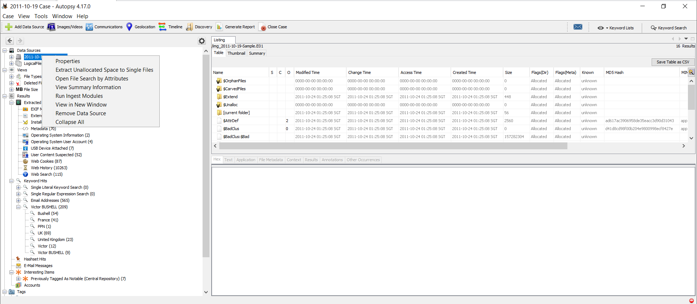
Autopsy – Ingest Module
There is also a manual way to run ingest modules.
This can be used when there are new evidences added to the case, as all the initial evidences would already be scanned.
Once the ingest module has completed scanning, the data will be added alongside all the other data.
Notes:
FI can manually run ingest module. This can be done when new evidences are added to the case and will not affect current evidences in Autopsy.

Slide 5
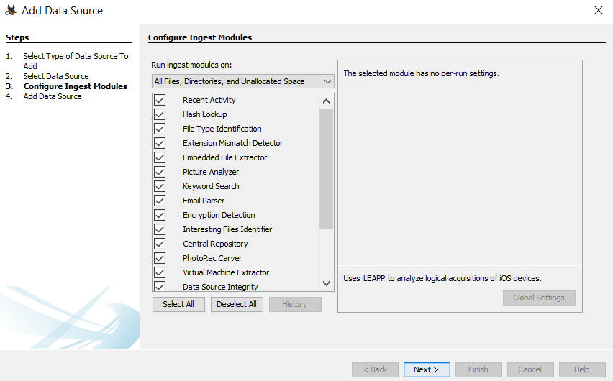
Autopsy – Ingest Module
When adding a new data source, Autopsy will automatically run the ingest modules.
It can also be set to be able to run at a later timing.
Notes:
When adding a new data source, Autopsy will automatically run the ingest modules once the options are selected by FI.

Slide 6
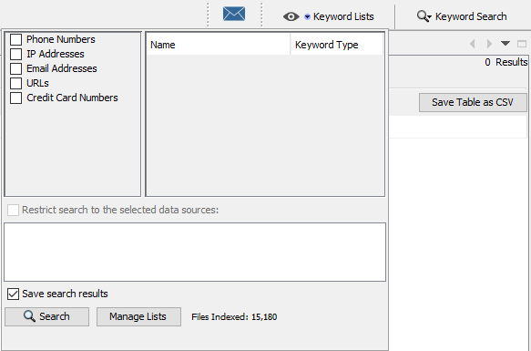
Autopsy – Keyword Search
This shows an image where investigators can use predefined or own keyword lists based on a particular case to obtain information associated to the keywords.
The FI can also choose to exclude certain keywords to save some time on the search.
Notes:
This shows an image where investigators can use predefined or own keyword lists based on a particular case to obtain information associated to the keywords.
The FI can also choose to exclude certain keywords to save some time on the search.

Slide 7
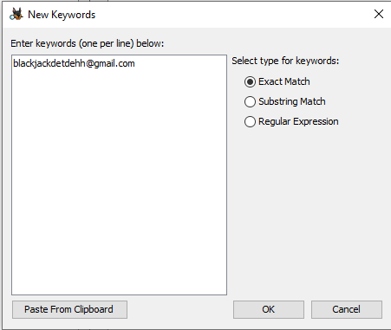
Autopsy – Keyword Search
When predefining their own keyword, the FI has the option to choose to select the keyword type to be either “Exact Match”, “substring Match” or “Regular Expression” as shown on the image shown on the right.
As shown, the email blackjacketdehh@gmail.com was used as the sample keyword.
Keywords can range from email addresses, names to aliases, etc.
Notes:
FI can predefine their own keywords and select the keyword type to be one of three types, “Exact Match”, “Substring Match” or “Regular Expression”.
The image on the right shows the FI adding in the email address of a suspect as a new, predefined keyword.

Slide 8
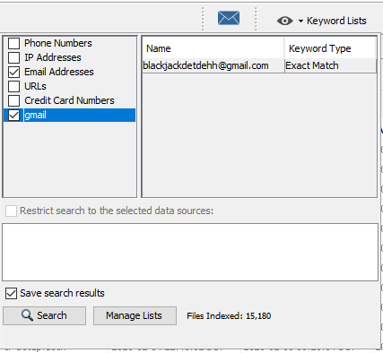
Autopsy – Keyword Search
FIs can also select predefined keyword lists from autopsy such as Credit Card Numbers, URLs and Email Addresses.
The FI can also add on to the already predefined or existing list so allow the keyword search process to be faster, instead of creating a new list every time new evidence appear.
Notes:
Autopsy also loads predefined lists such as credit cards and URL formatting. FI can add on to it instead of creating a new list all the time.

Slide 9
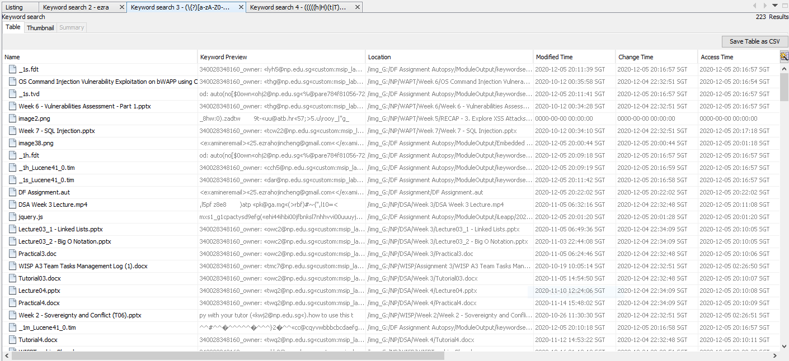
Autopsy – Keyword Search
Notes:
The results will be displayed in this manner, where the FI can go through each result and determine if the information obtained was useful or not.

Slide 10
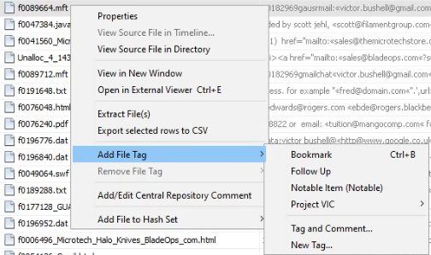
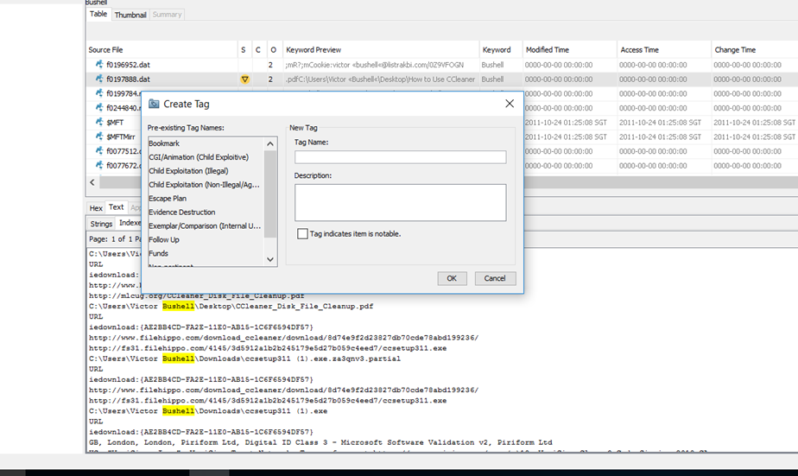
Autopsy - Bookmarking
Follow Up – Look at evidence later since it is suspicious
Notable Item – Most likely used to save incriminating evidence
FI can create their own tags e.g. Escape Plan, Evidence Destruction, Funds
Notes:
There are two levels of bookmarking
Follow up – look at evidence later as the evidence is suspicious
Notable Item – most likely incriminating evidence
FI is also able to create their own tags – e.g. Escape Plan, Evidence Destruction and Funds are a user created tag in the image above red box.
The image on the right shows how users can create their own tags pertaining to their own case.

Slide 11
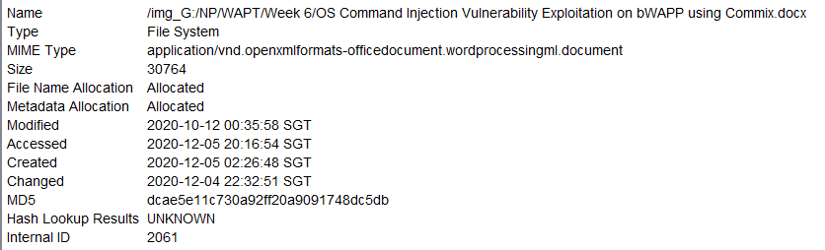
Autopsy – Extracted Content View
This is the EXIF metadata, containing information such as Created,, Accessed, Modified details.
May not be viewable since the MAC times and dates of evidence may not match the time where files were originally created
Notes:
This shows the EXIF metadata, which contains data such as the created, assessed and modified details of the files.
It may not be viewable since the MAC times and dates of evidence may not match the time where files were originally created.

Slide 12
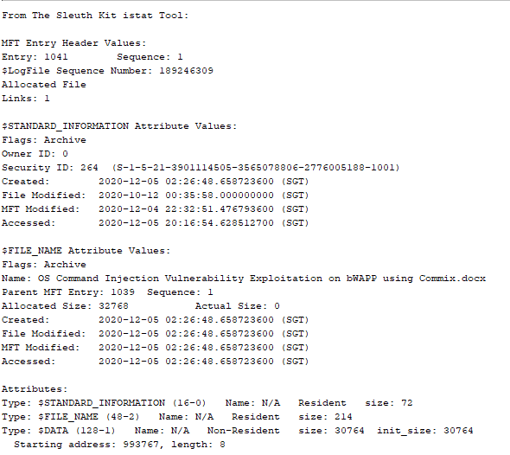
Autopsy – Extracted Content View
This is the Sleuth Kit istat Tool, which can be used on all files
This is a tool which is used to provide more information to the FI regarding the file.
It can show all sorts of information such as
Security ID
Parent MFT Entry
Starting address of the file
Resident size and more.
Notes:
The Sleuth Kit istat tool is built inside Autopsy and provides more information about the file such as the type, the resident size, and more.

Slide 13
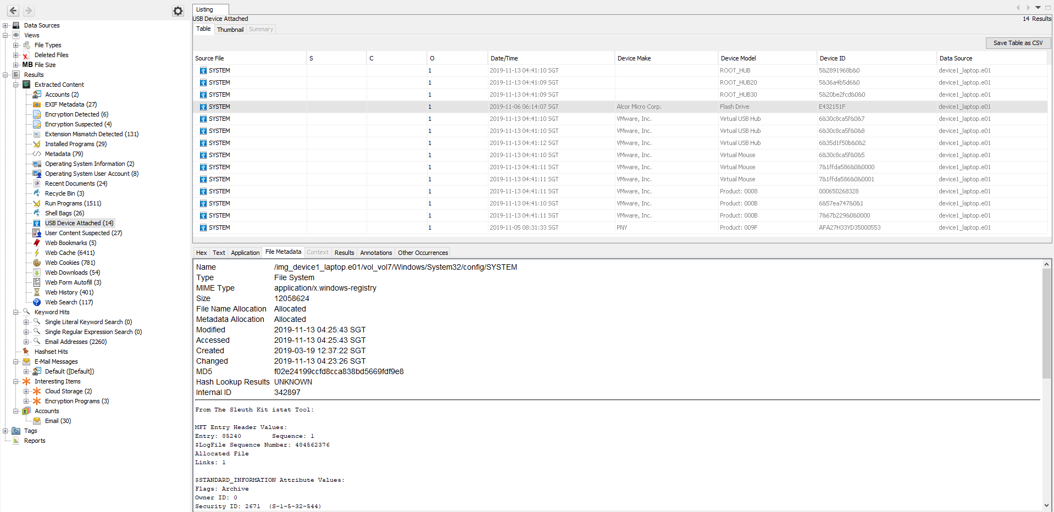
Autopsy – USB Devices (Extracted Content View)
Notes:
USB Devices attached are also detectable by Autopsy as shown by the image.
Although it does not show any data contained within the USB device, it is enough knowing that there is a USB device at the point of imaging the device. The USB device can be analyzed separately afterwards.

Slide 14
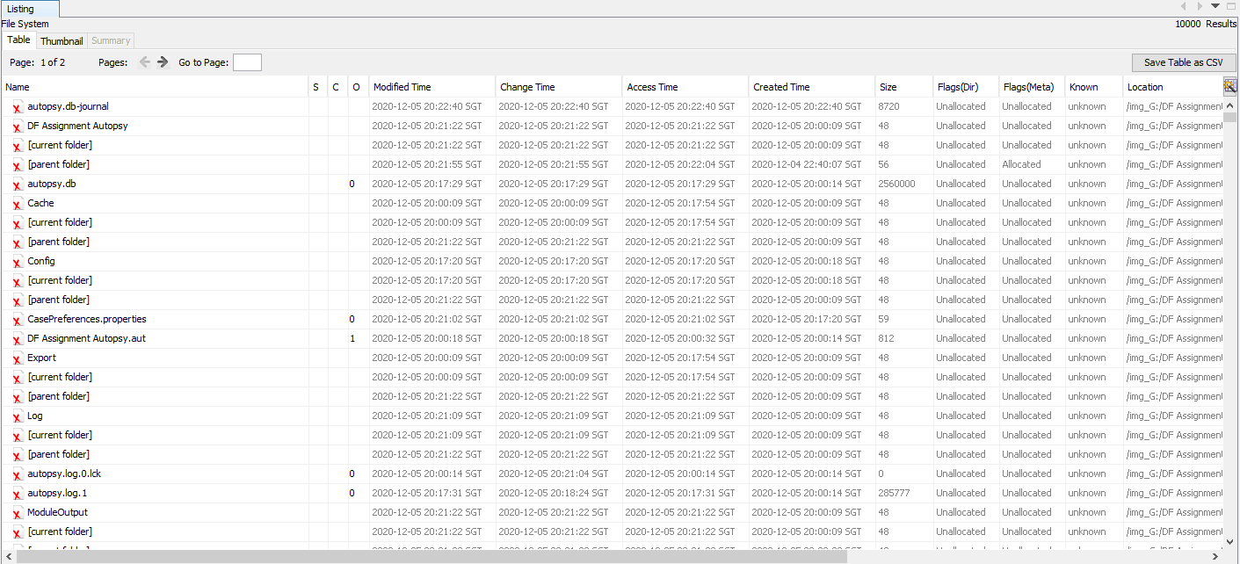
Autopsy – Deleted Files (Extracted Content View)
Notes:
Autopsy can view deleted files from all sources such as the C drive of the device to the deleted files found on a USB drive. This is extremely helpful to investigators as they can easily view the names of the files which were deleted, which could potentially find them a good lead on the case.

Slide 15
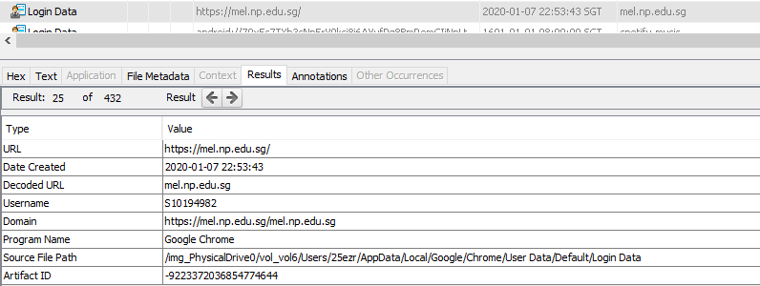
Autopsy - Accounts
Provides comprehensive history on the accounts that the suspect has on the device.
Shows the websites that the suspect has a registered account on the platform
Obtained by bit-by-bit image copy of the boot drive or when live acquisition is performed
Allows FI to sort malicious websites and accounts, which might have aided the suspect into committing the crimes
Notes:
It provides a comprehensive history on the accounts that the suspect has on the device. It shows the websites that the suspect has a registered account on that platform.
This can only be obtained though a bit-by-bit image copy of the boot drive or when FI is performing live acquisition.
It can be seen the exact date and time the account was created, the domain and username which was used to create the account.
It provides investigators with an easier time to sort out suspicious accounts which may have aided the suspect to perform malicious actions. Also shows the source file path of this event, which the investigators can use to extract more data.

Slide 16
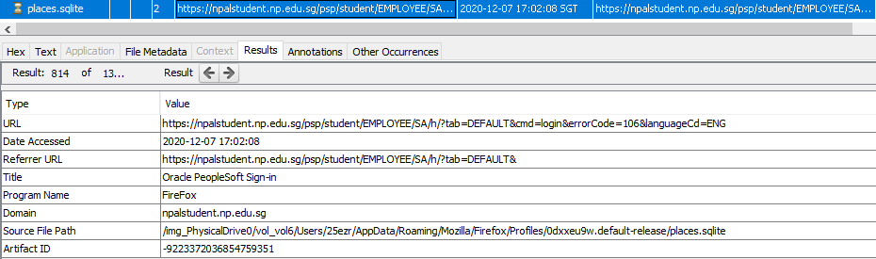
Autopsy – Web History
Shows the web history of suspect after ingest module is complete.
Only obtained when bit-by-bit copy of boot drive or live acquisition is performed
Contains details from all browsers and records all the websites the suspect has been to. The time, date and URL are clearly indicated.
In the picture above, the suspect accessed npalstudent on 7th December 2020 using Firefox Internet Browser and data was saved on the app data shown by the source path.
By using this knowledge, the FI will be able to track down websites and leads to find out what the suspect did.
Notes:
Web History shows the web history of the suspect after Autopsy has completed scanning the boot drive. This can only be done when the device of the suspect is scanned using Autopsy or a bit-by-bit copy of the boot drive of the suspect is obtained and scanned via Autopsy.
It contains details from all the browsers and records all the websites the suspect has been to. The date, time and URL are clearly indicated, and investigators can sort the history according to name, date accessed, titles and more.
In this example, the suspect accessed npalstudent on 7th December 2020 using Firefox Internet Browser. The data was saved on the app data as shown by the source file path.
By having this knowledge and the expansive access to the details of a suspect’s web history, the investigator could have a much easier time tracking down websites and finding leads as to what the suspect has done.

Slide 17
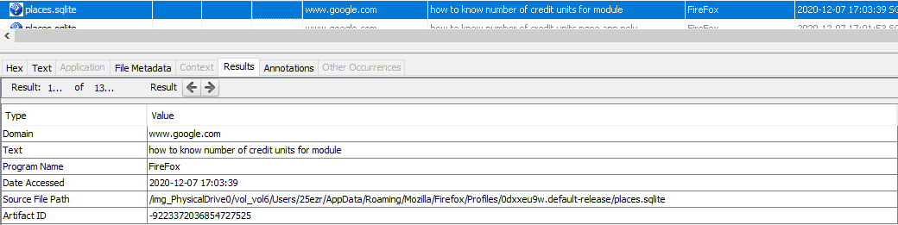
Autopsy – Web Search
Web search mainly shows columns containing the domain, search text, program name, and date accessed as shown in the image below.
Helpful for investigators when searching for clues as to what the suspect did. There should be leads just by going through the Web Search History and Web History of the suspect
Notes:
The web search mainly shows columns containing the domain, the search text, the program name, and date accessed as shown in the image below.
This is helpful for investigators who must search for clues on what the attacker did and how it was done. The investigator could more easily find exactly what a suspect did just by going through the web search history and web history of the suspect.

Slide 18
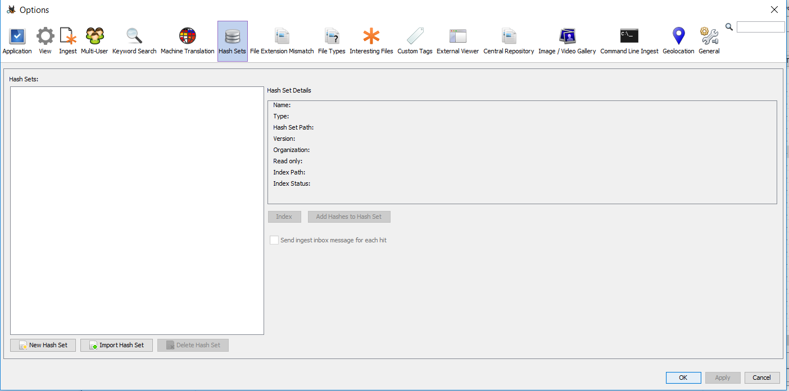
Autopsy - Addons
FI can provide hash databases of common uninteresting files, often requiring download from the internet. This can also be used for malware detection based on their hash value.
Notes:
Autopsy allows FI to provide hash databases of common uninteresting files which often requires download from the internet. It could also be used for malware detection based on their hash values.

Slide 19
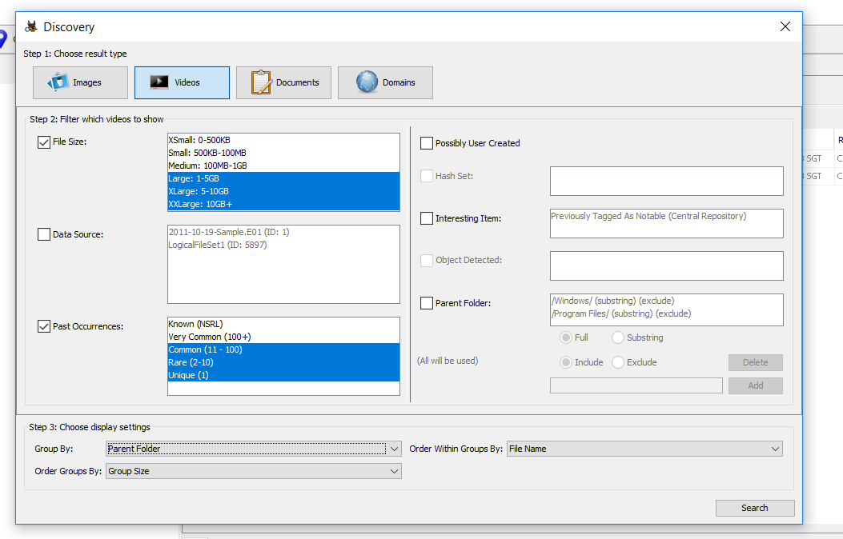
Autopsy - Addons
Discovery Option enables FI to narrow down the search by filtering through certain properties or metadata of the file.
Notes:
The Discovery option enables Fi to narrow down the search by filtering through certain properties or metadata of the file.
Hash sets can also be included when search using this option.

Slide 20
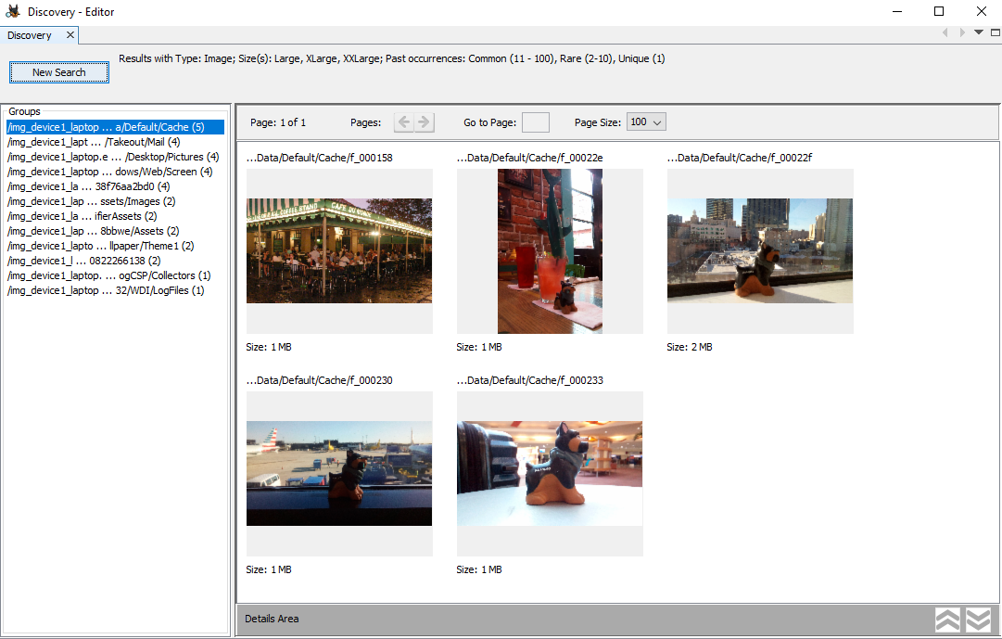
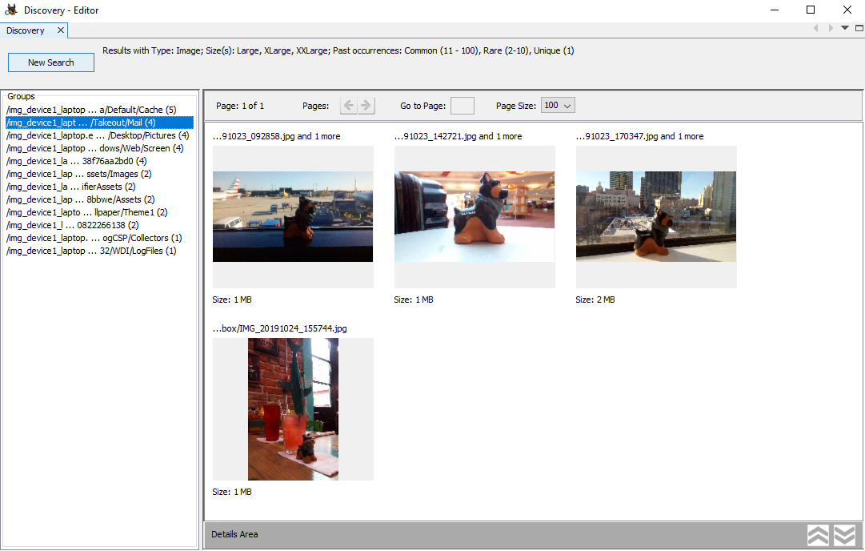
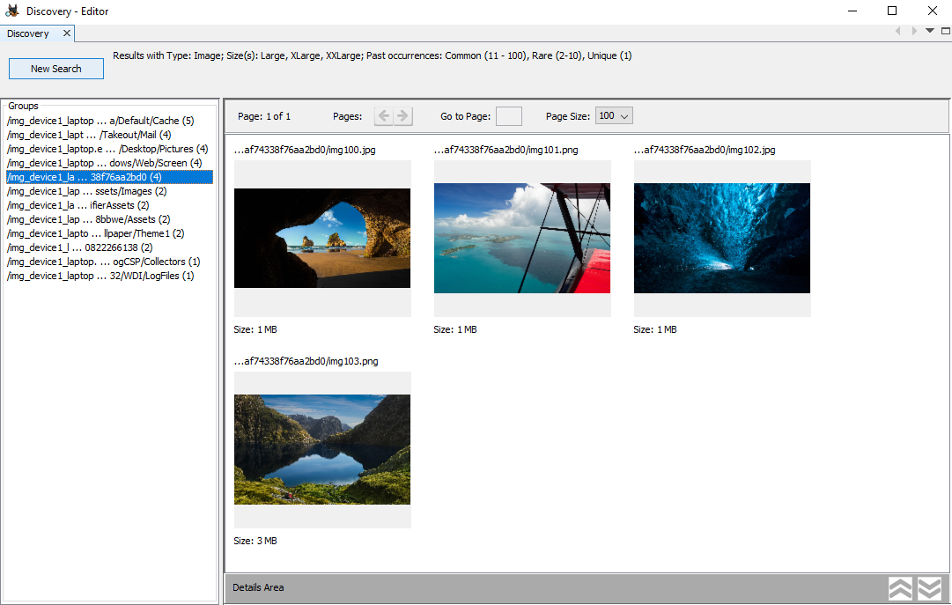
Autopsy - Addons
The images show the search results of the Discovery Search performed.
Notes:
These are the results performed by the Discovery Search performed.

Slide 21
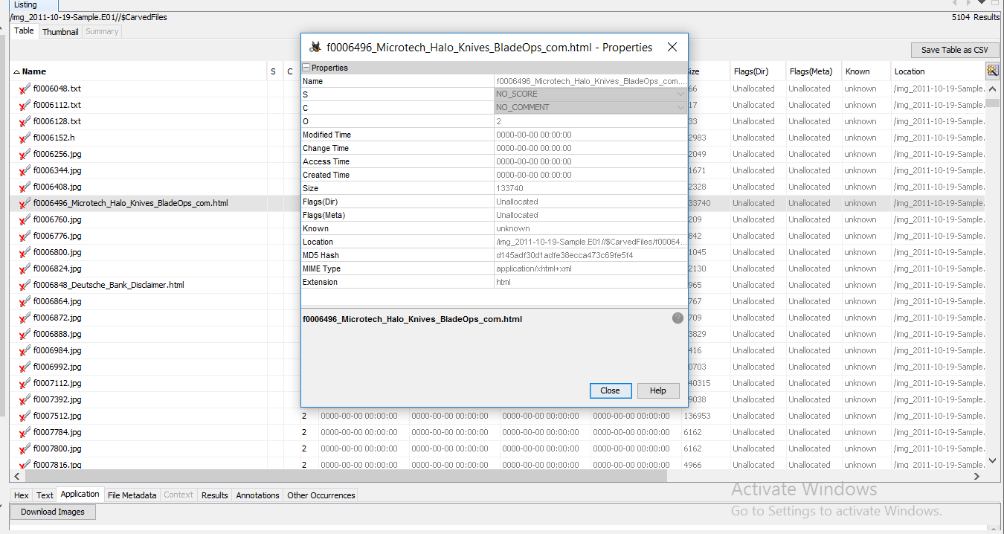
Autopsy - Addons
File metadata is also available for each individual file including the number of occurrences (O), comments (C) and tag (S).
Notes:
File metadata is also available for each individual file including the number of occurrences (O), any comments (C) and tag (S).

Slide 22
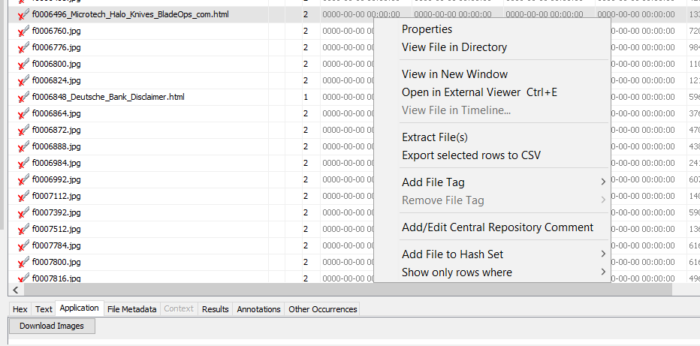
Autopsy - Addons
File extraction is possible for unsupported application formats (displayed as strings or text)
Corresponding application may be needed to view the file if unsupported by Autopsy
Notes:
File Extraction is also possible for unsupported application formats (Autopsy displays it as strings or hex), so a corresponding application may be needed to view the file if it is unsupported by Autopsy.

Slide 23
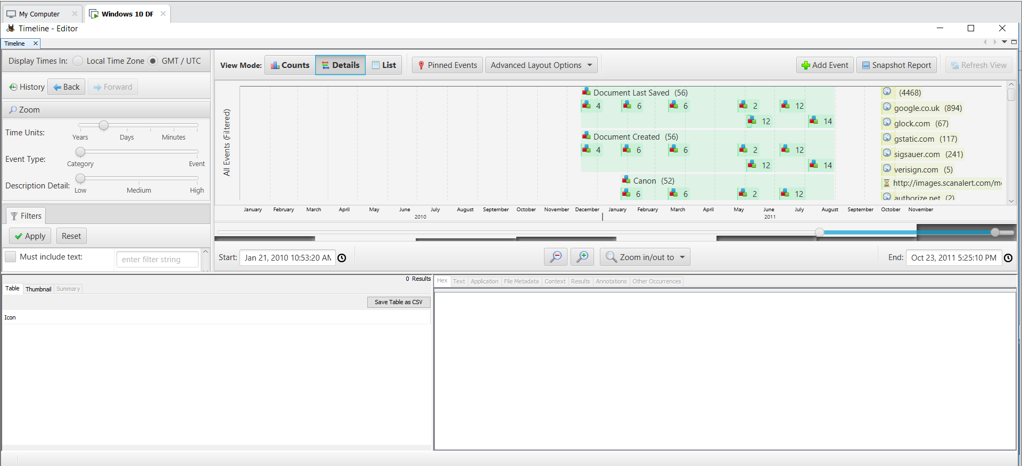
Autopsy - Timeline
The timeline allows Fi to analyze the timeline of events for the most possible time and sequence of events before crime was committed.
Shows file that were created / modified.
Notes:
This option allows FI to analyze the timeline of events for the most possible time and sequence of events before the crime was committed. It shows files that were created and/or modified.

Slide 24
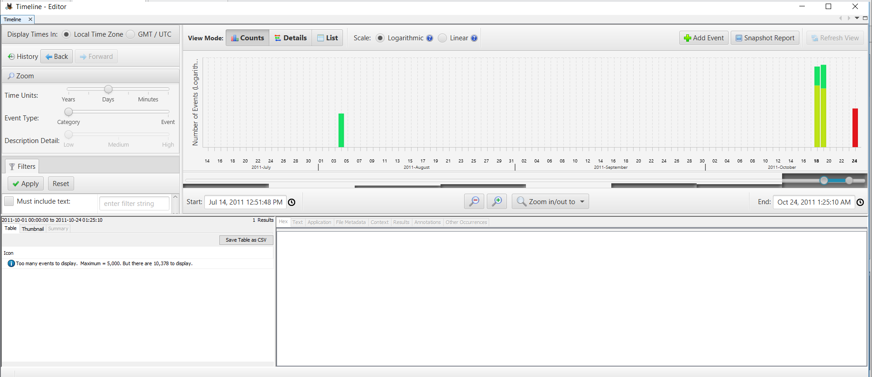
Autopsy - Timeline

Slide 25
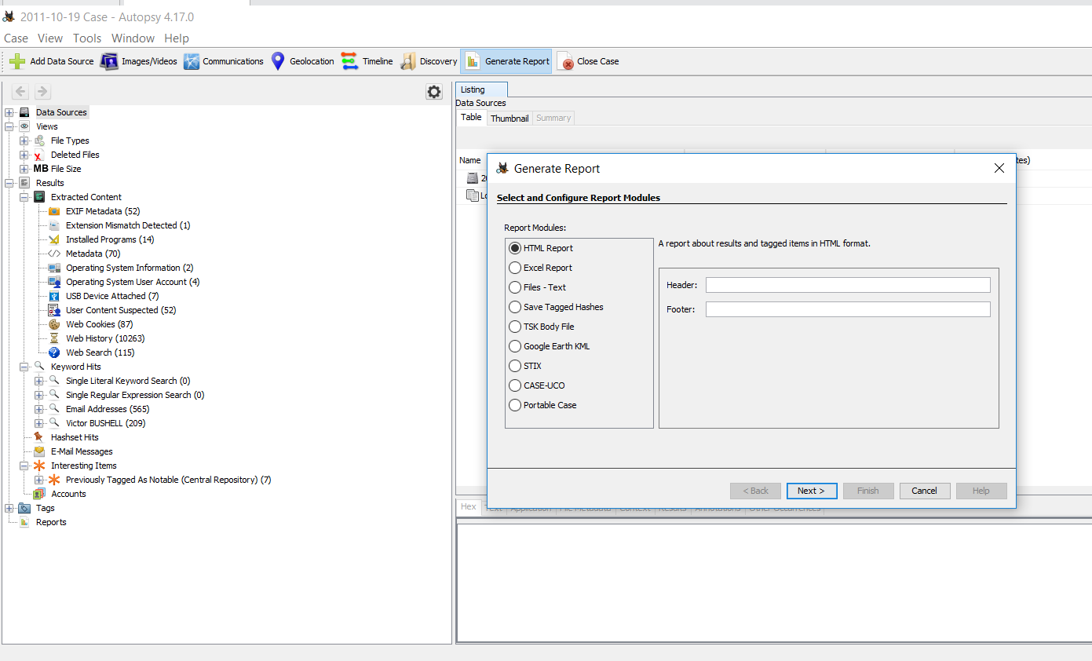
Autopsy - Report
Report can be generated and contains key information regarding the case
Mostly contains what the FI has bookmarked
Can be saved in a few formats such as HTML Report, Excel Report and Files - Text
Notes:
Report can be generated, and it contains key information regarding the case which is mostly what the FI has bookmarked. It can be saved in the few formats shown here.

Slide 26
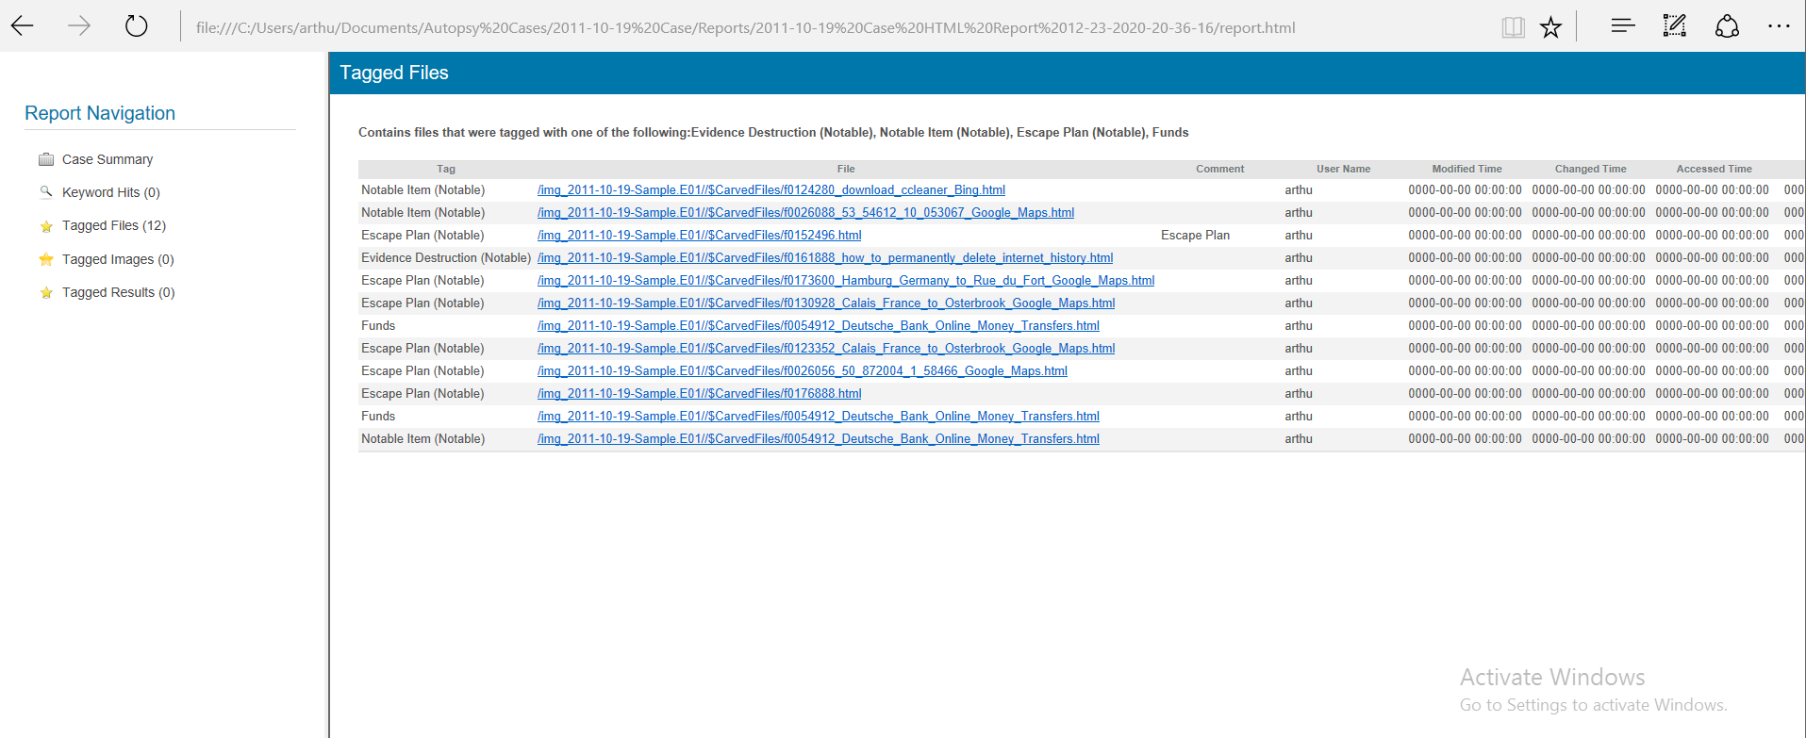
Autopsy - Report
There is an option to determine what goes into the report
E.g. Follow Up tags might be excluded as it is only needed during the investigation and not useful in the court of law
Notes:
There is the option to determine what goes into the report (e.g. follow up tags might be excluded since it is needed only during the investigation and might not be useful in a court of law)

Slide 27
Case Scenario
This is a Kidnapping Case of a Dog—Renzik. The Dog was eventually rescued and the perpetrator was arrested, with his computer seized. You as a forensic investigator are required to conduct a forensic investigation to find out why Renzik was kidnapped and provide sufficient evidence for the kidnapper to be charged in a court of law.

Slide 28
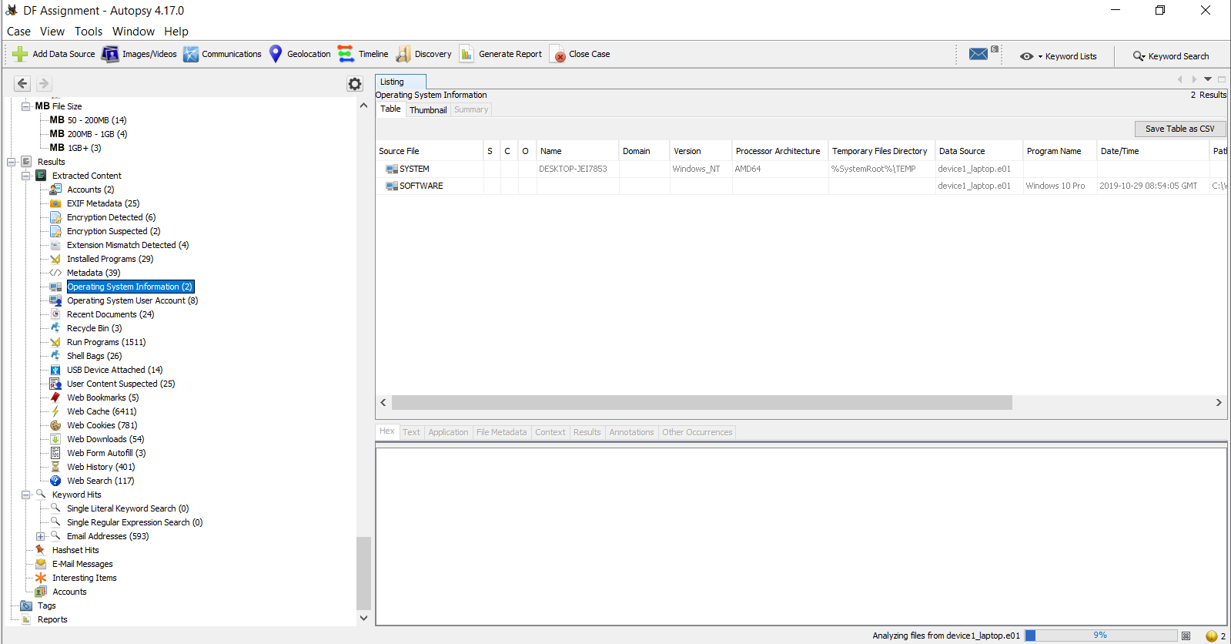
OS Information

Slide 29
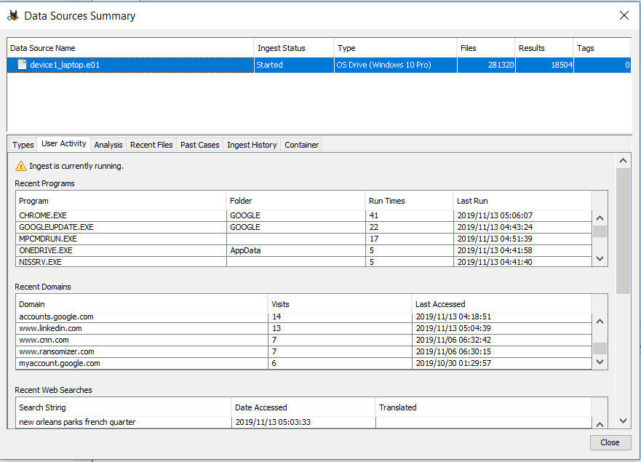
Activity in Data Source Summary
Suspect most likely used Chrome as default browser
Used ransomizer to create ransom note

Slide 30
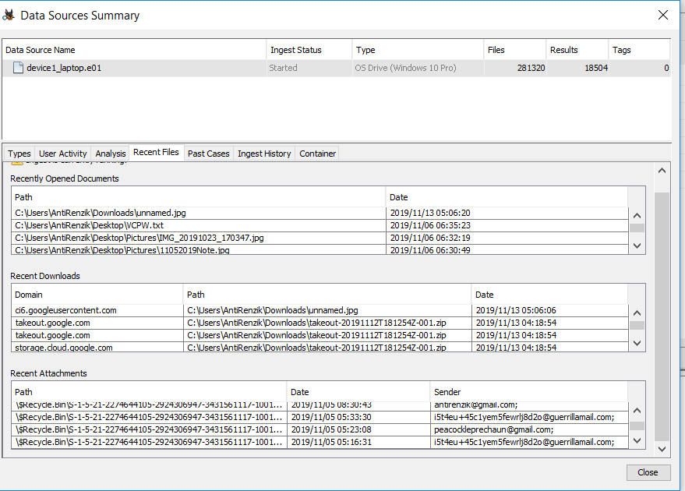
Recents in Data Source Summary
Attachments mostly deleted (in $Recycle Bin)—source majority from antirenzik@gmail.com, with some using guerillamail (temporary email service)

Slide 31
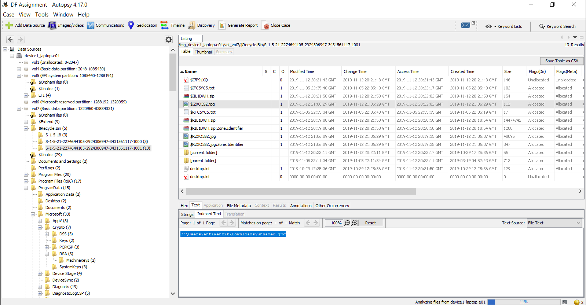
Evidence in Recycle Bin
Unnamed.jpg file in Recycle bin, original path in Downloads

Slide 32
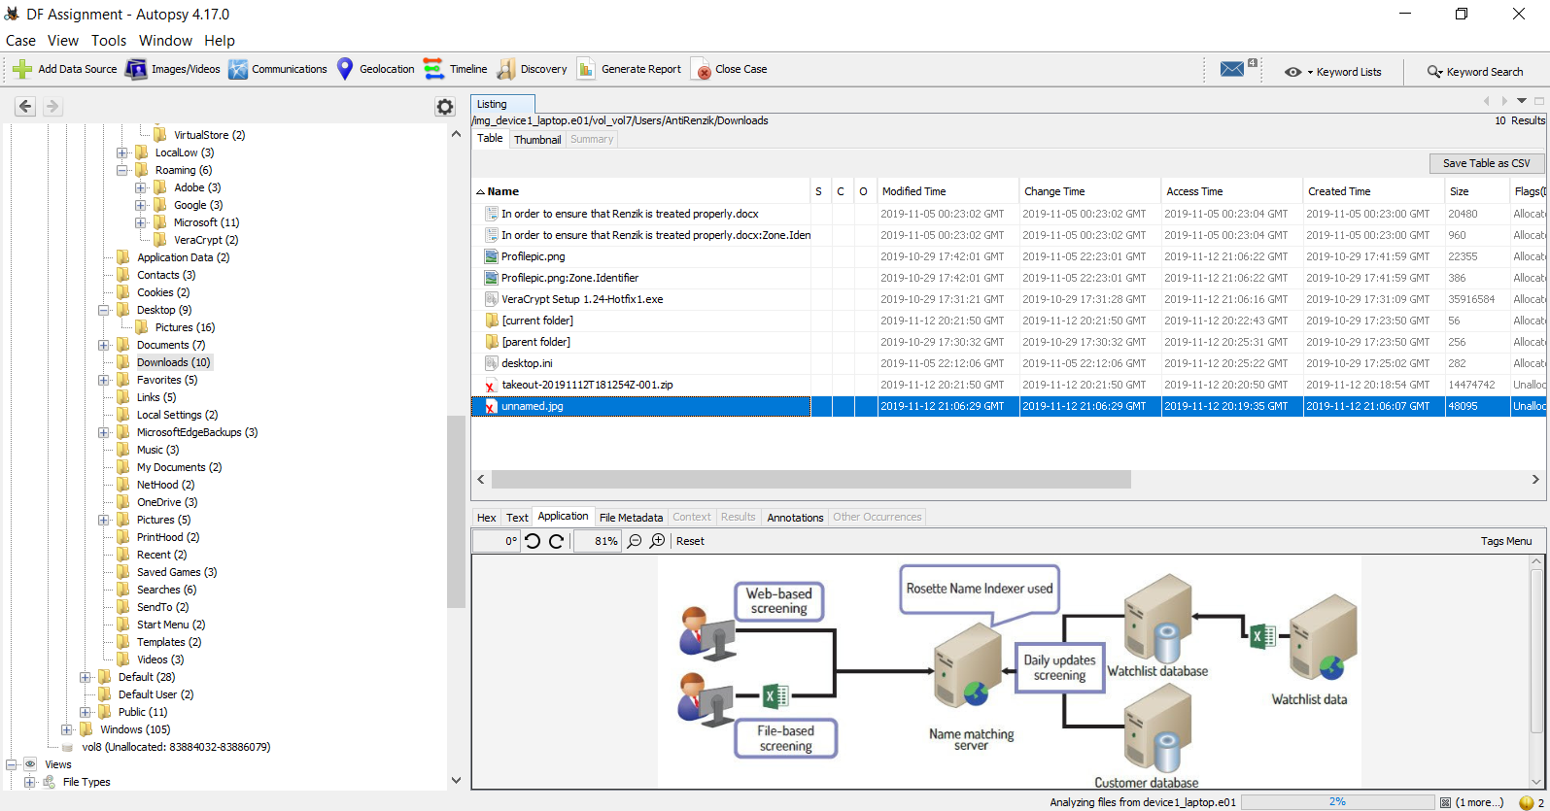
Some suspicious files in downloads

Slide 33
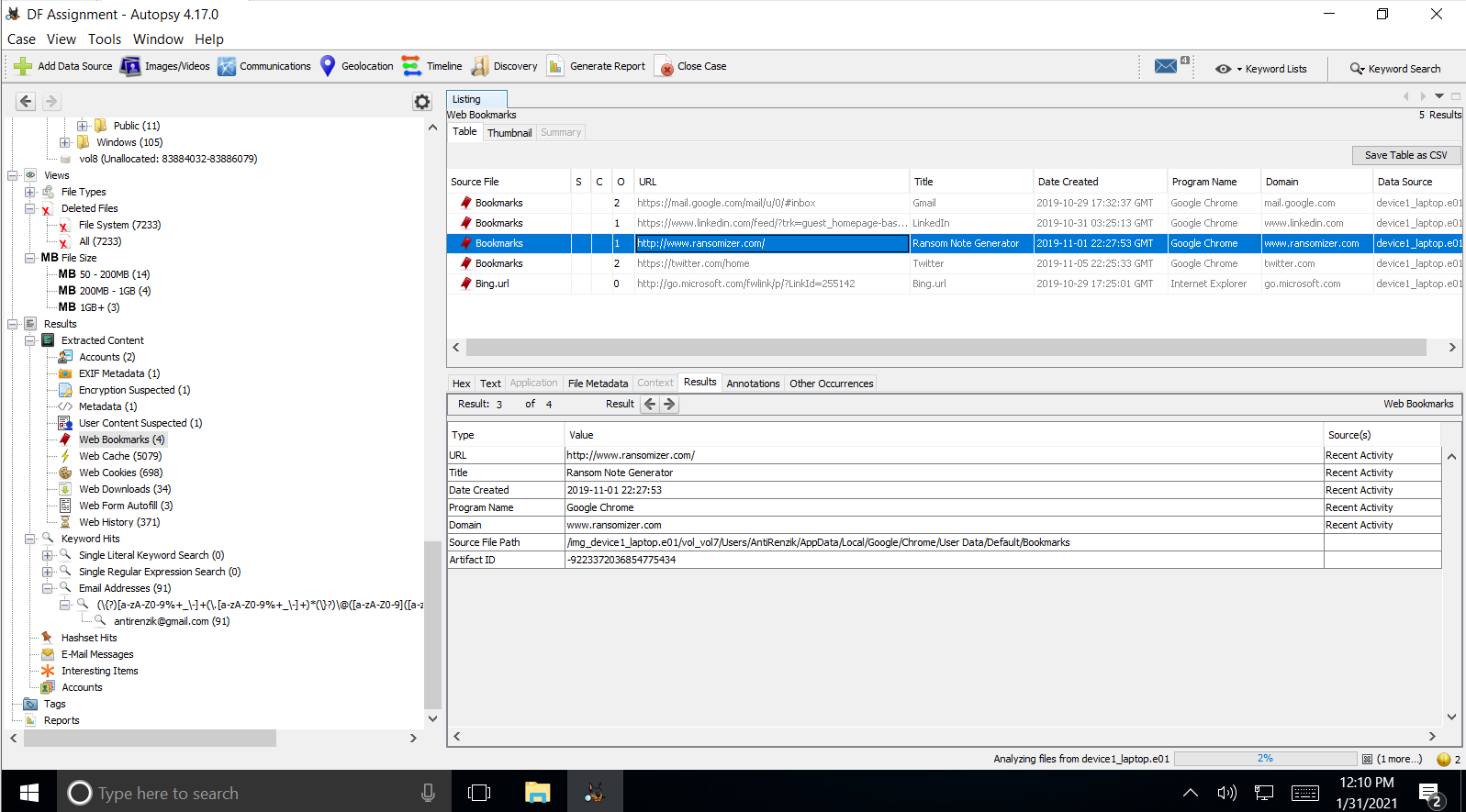
Ransom Note generator in Web Bookmarks

Slide 34
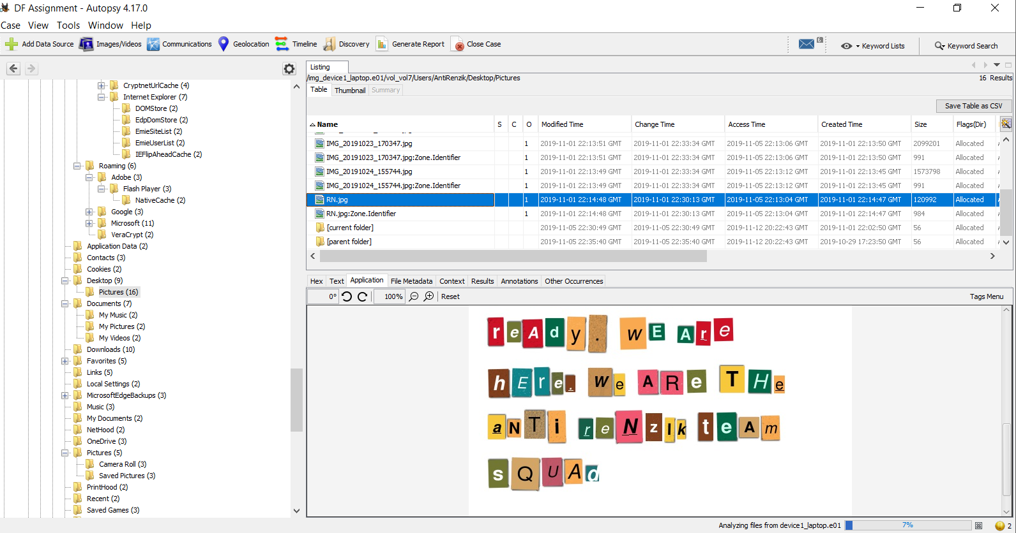
Ransom note in Pictures
Notes:
I have other versions of this other than this.

Slide 35
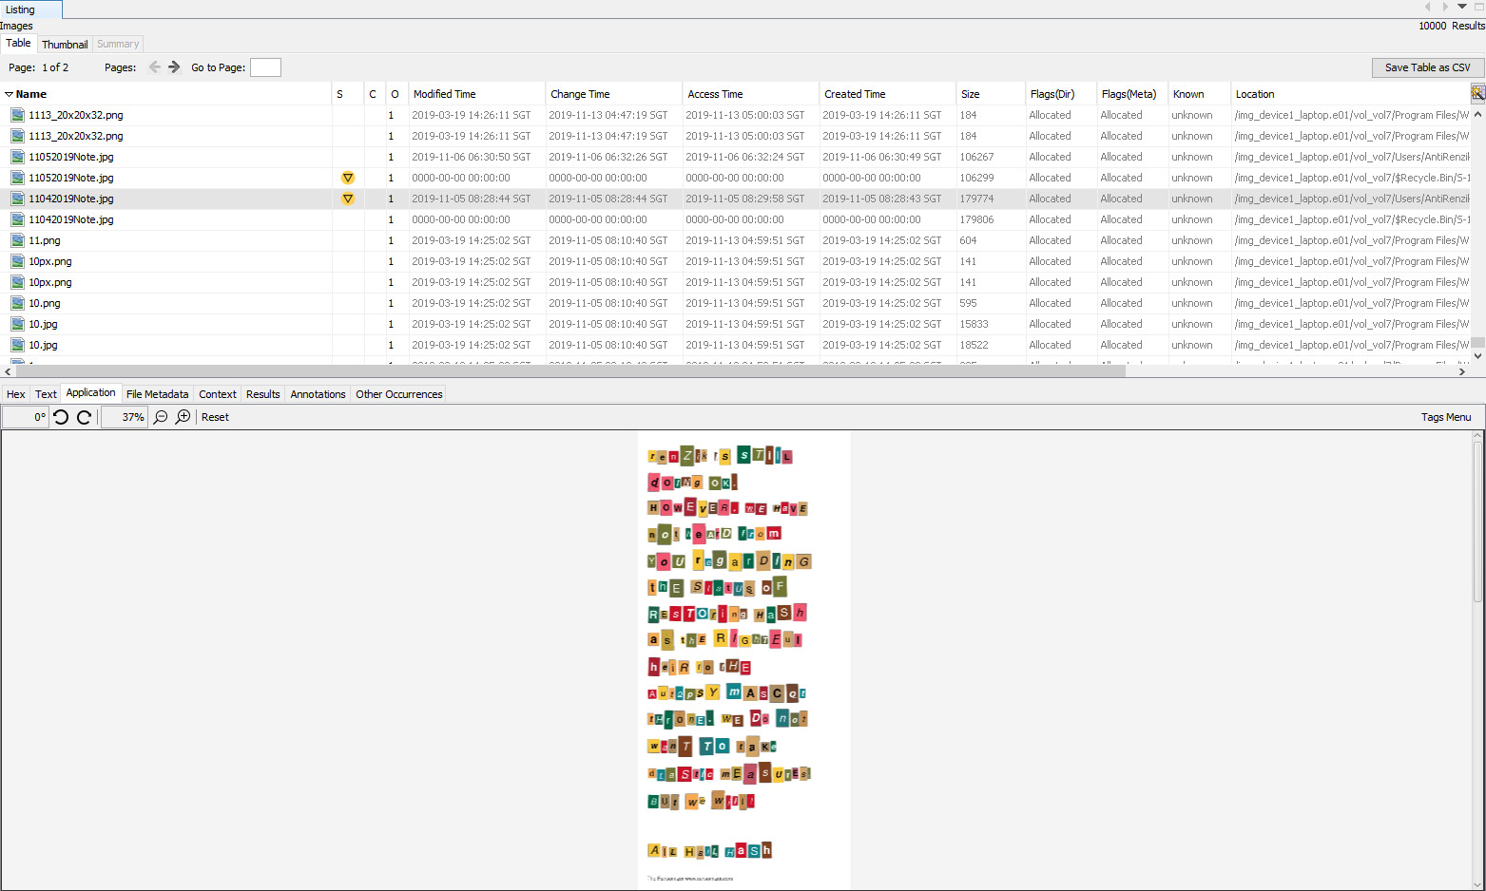
Ransom note in Pictures
Notes:
I have other versions of this other than this.

Slide 36
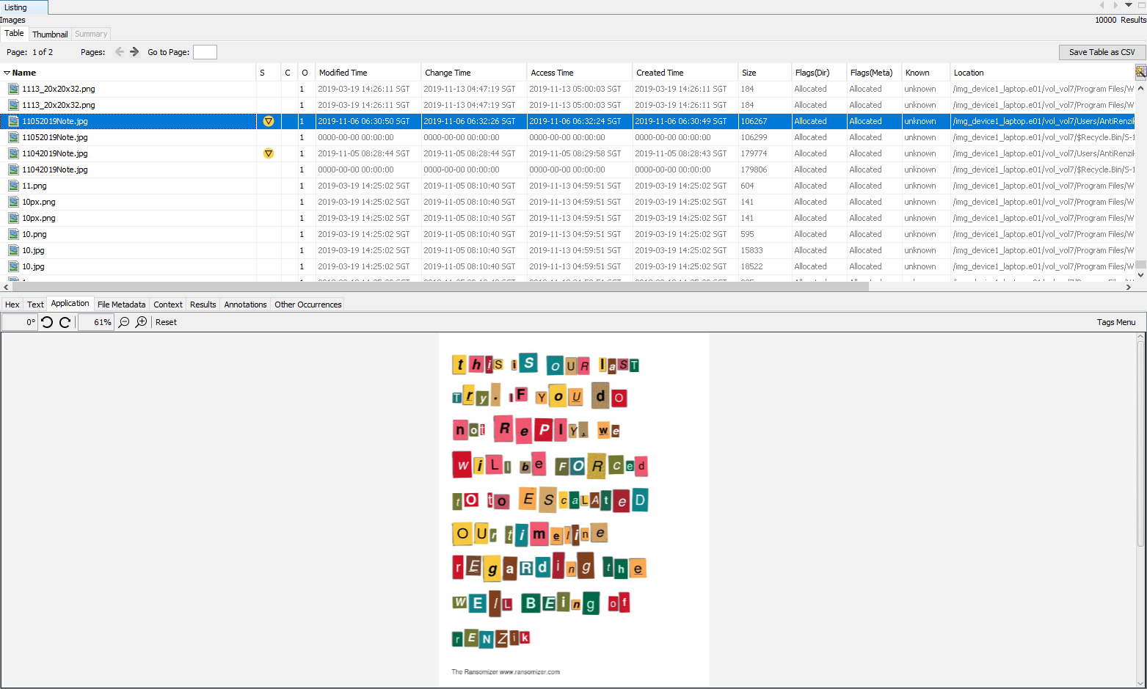
Ransom note in Pictures
Notes:
I have other versions of this other than this.

Slide 37
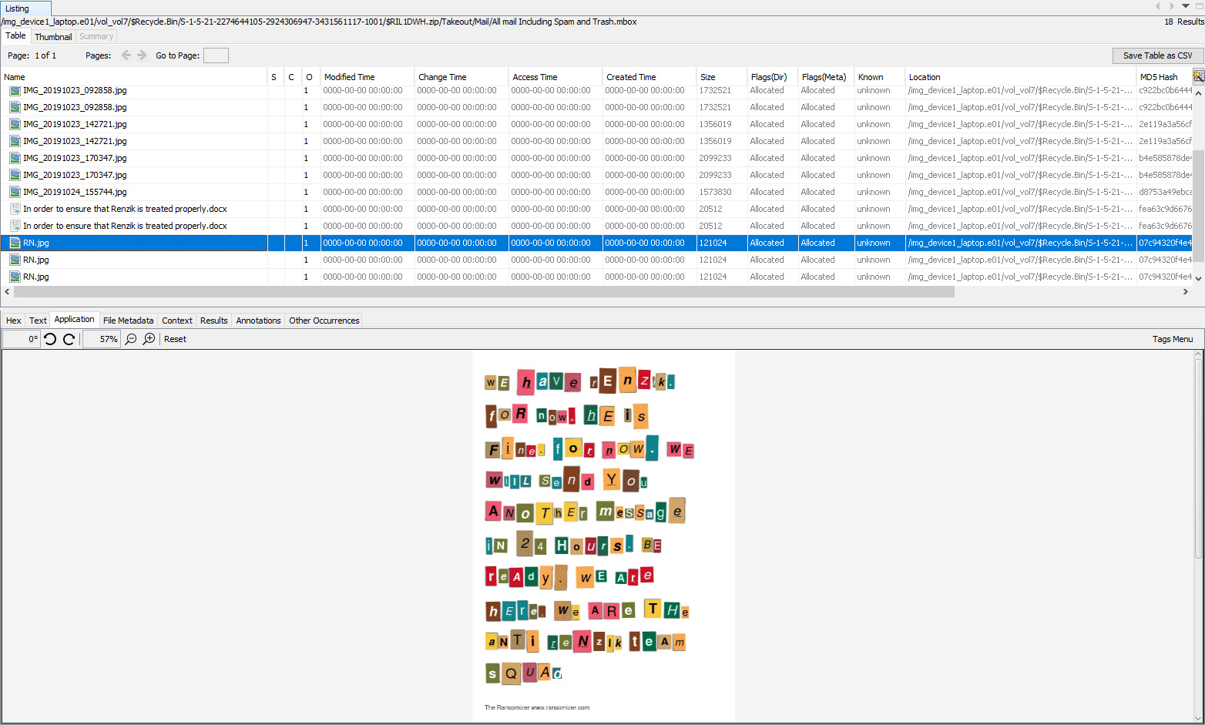
Ransom note in Pictures
Notes:
I have other versions of this other than this.

Slide 38
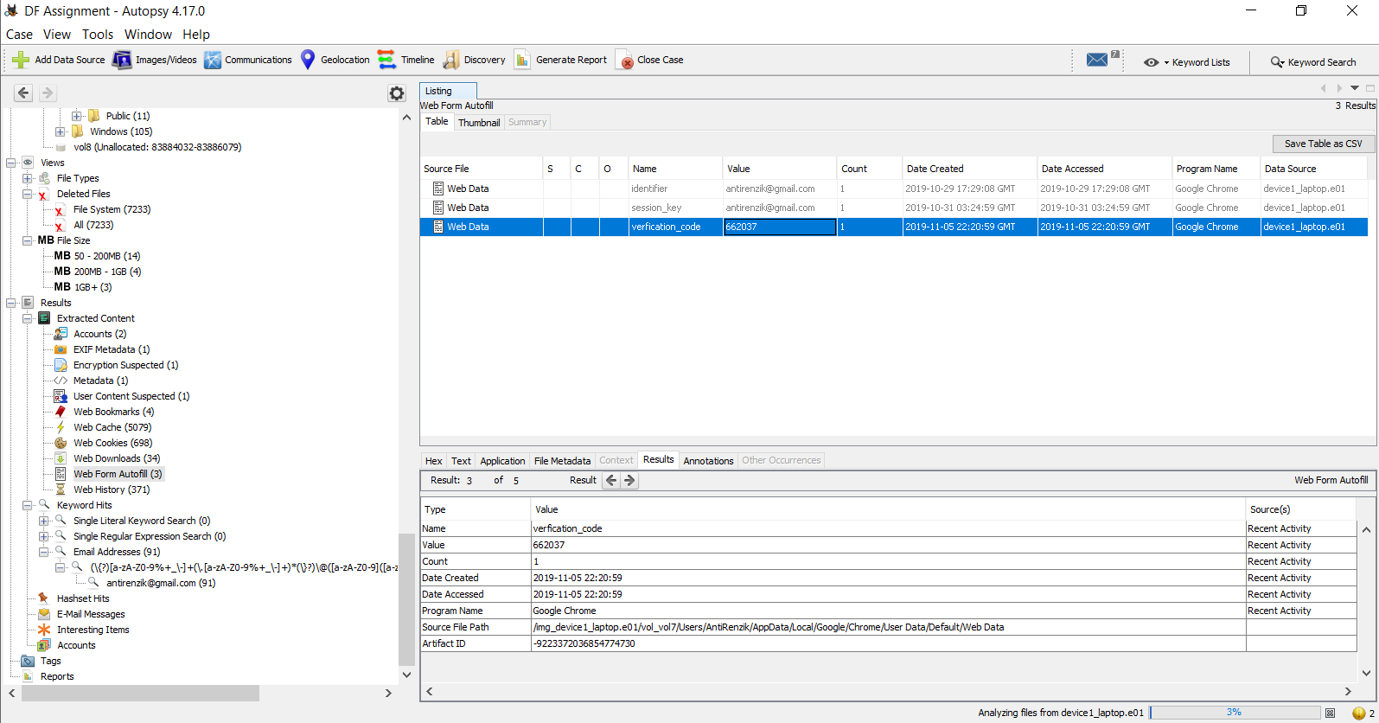
Probably has 2FA enabled for some account

Slide 39
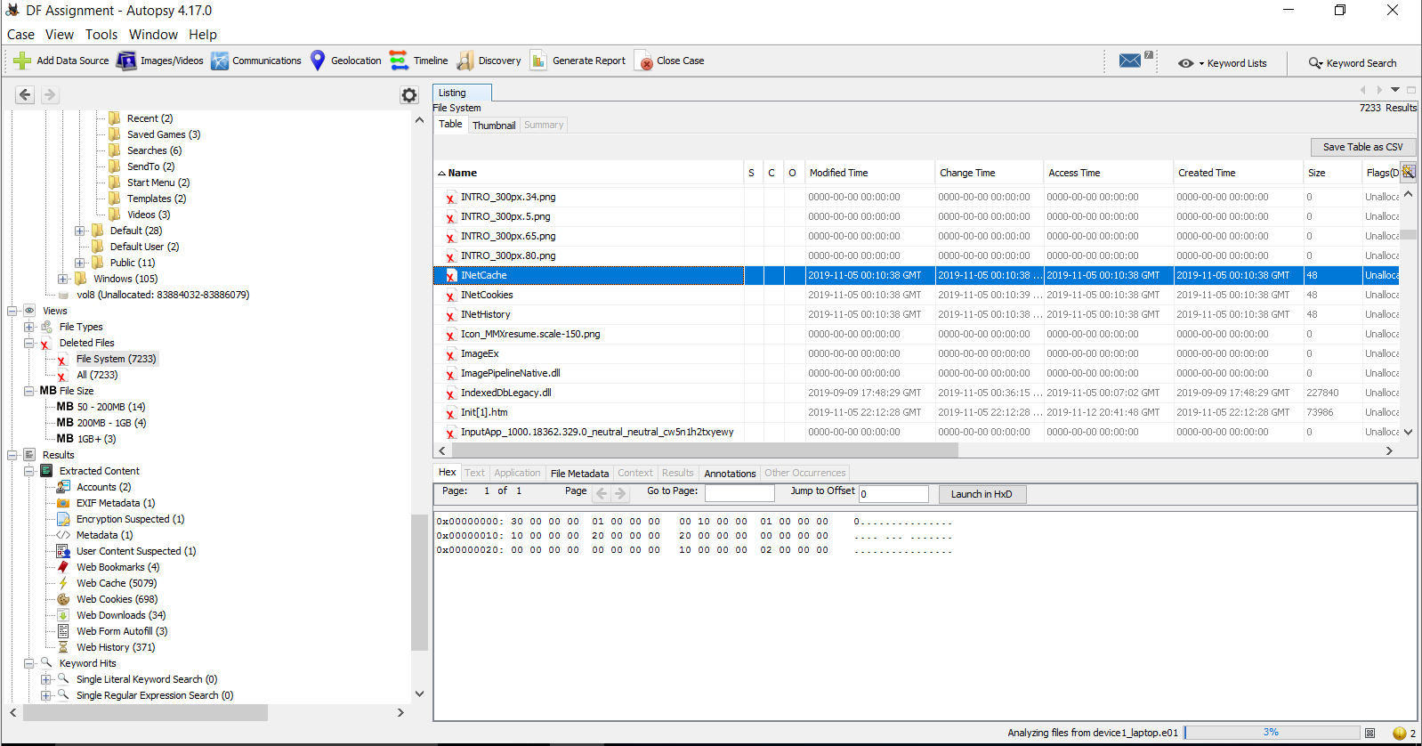
Possible Attempt to delete iNet related files to cover tracks
Notes:
I also cant find this

Slide 40
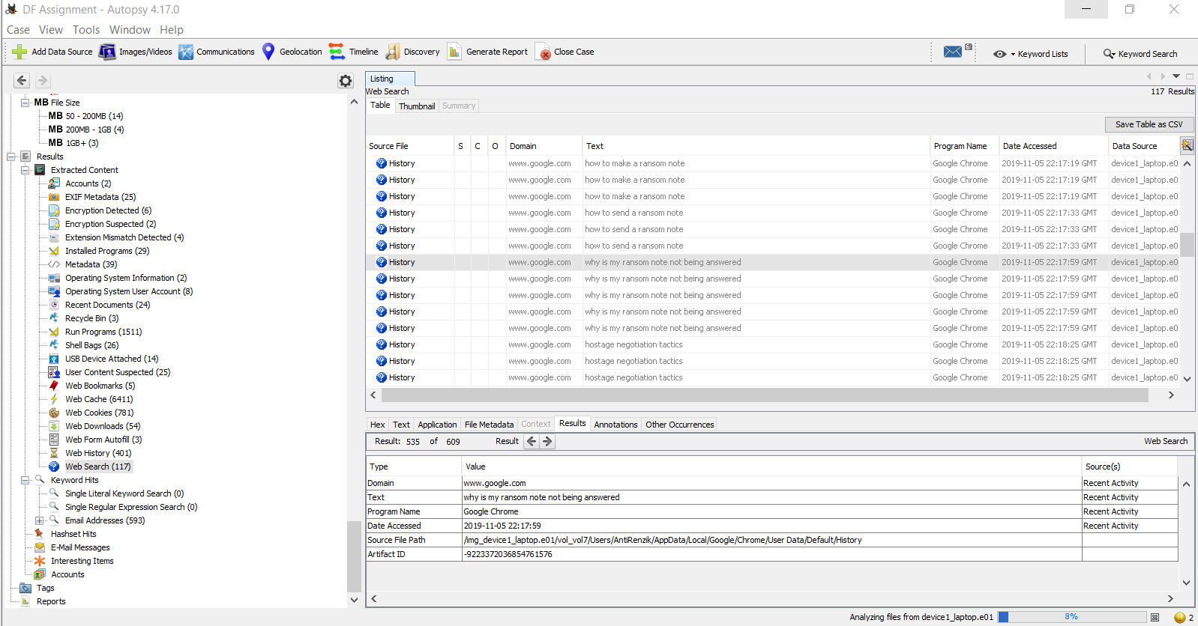
Suspicious Web Searches

Slide 41
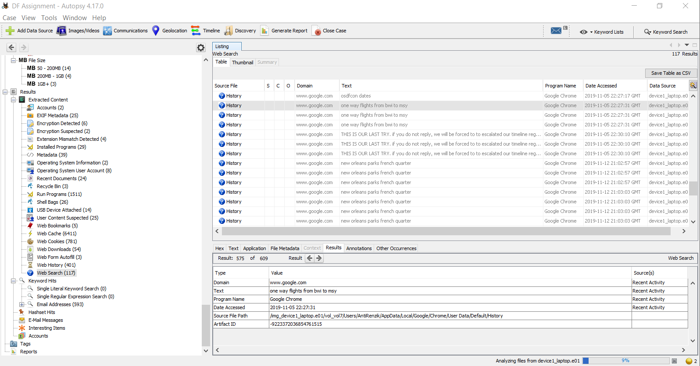
Suspicious Web Searches (Part 2)

Slide 42
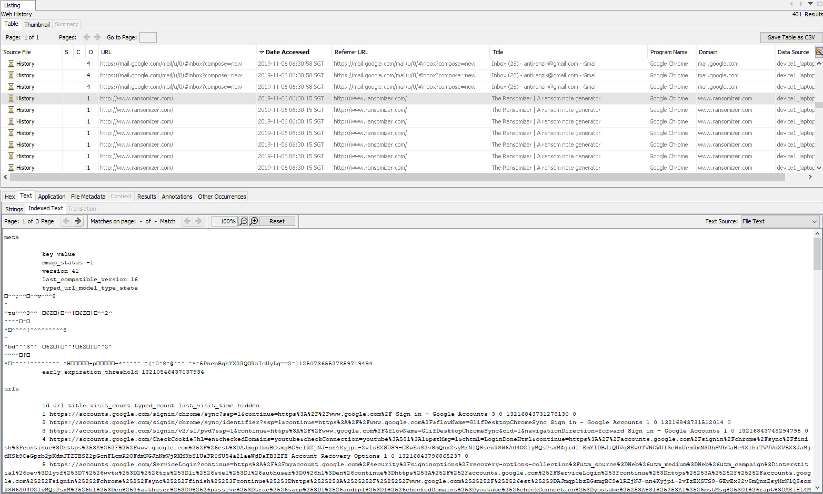
Suspicious Web Searches (Part 3)

Slide 43
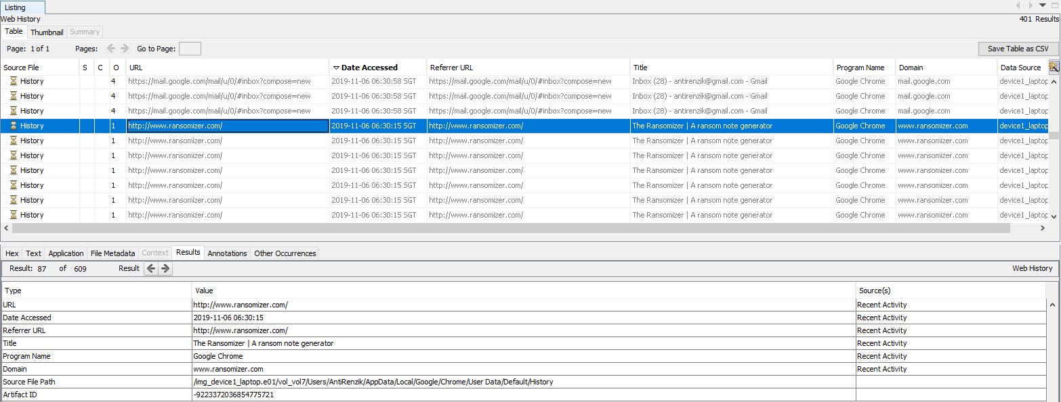
Suspicious Web Searches (Part 4)

Slide 44
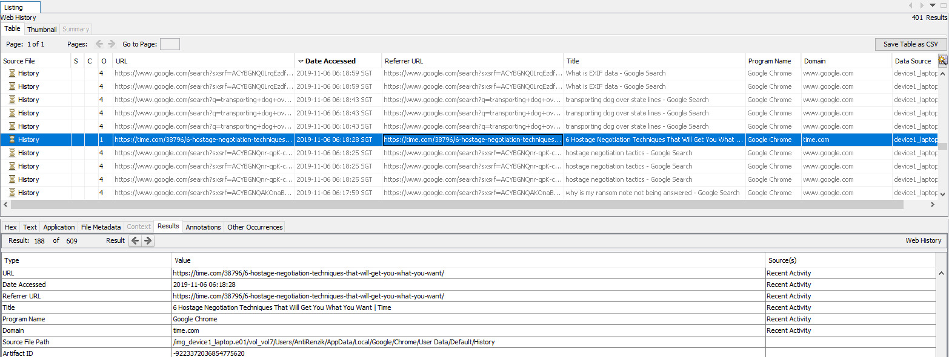
Suspicious Web Searches (Part 5)

Slide 45
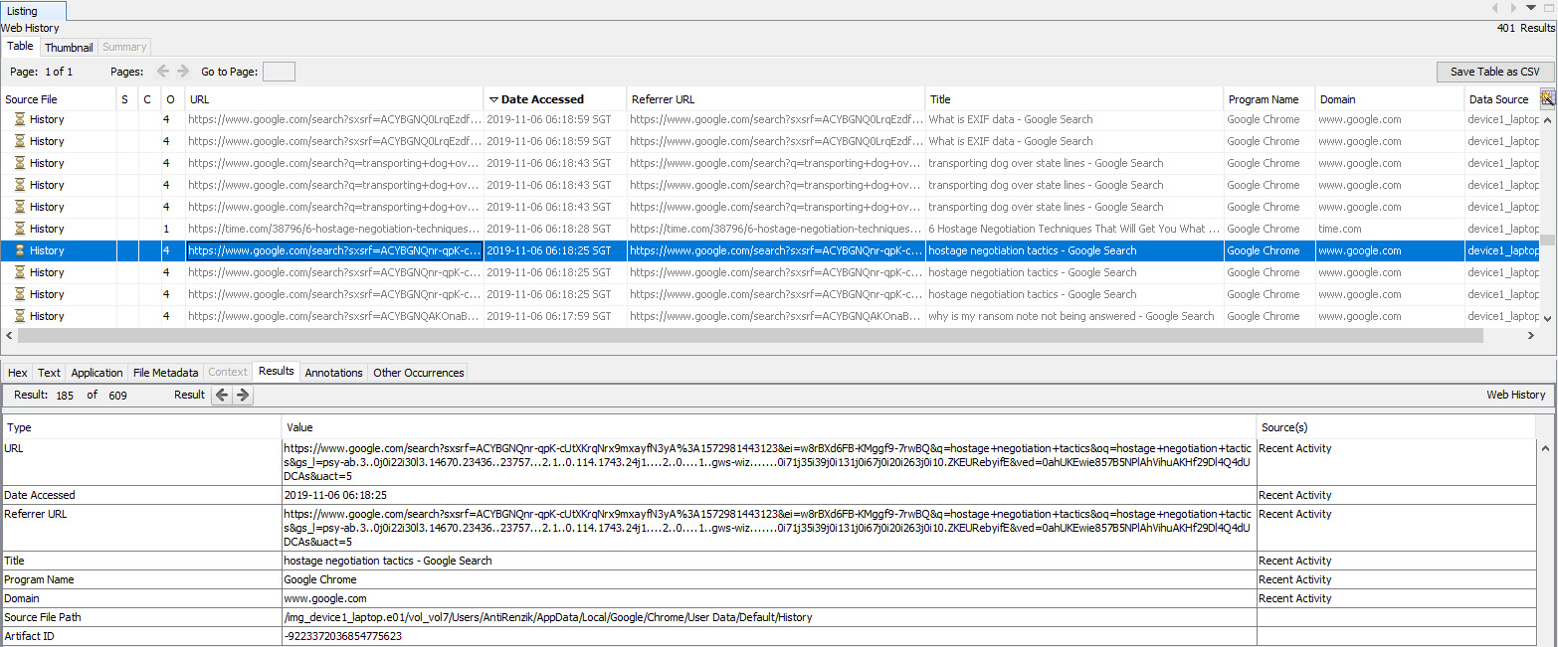
Suspicious Web Searches (Part 6)

Slide 46
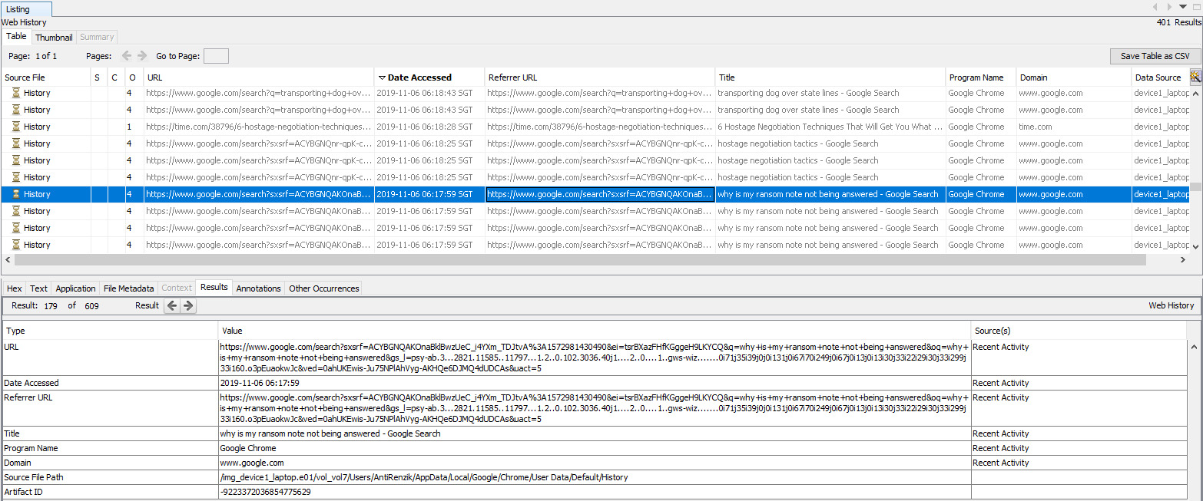
Suspicious Web Searches (Part 7)

Slide 47
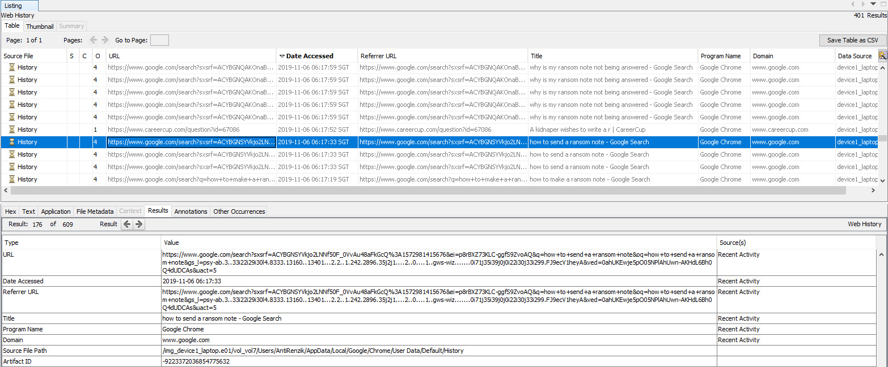
Suspicious Web Searches (Part 8)

Slide 48
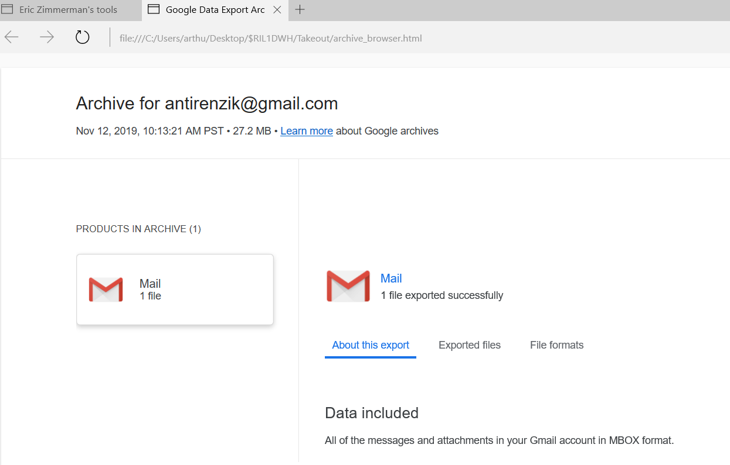
Mail Archive Extracted from Recycle Bin
Notes:
Where to find this

Slide 49
Plaso & Log2Timeline

Slide 50
Methodology
We will first use the log2timeline.py to create a memory dump.
Thereafter we will use pinfo.py to analyse the warnings and errors as well as some useful OS related functions
Finally, we will use psort.py to create the supertimeline which would be analyzed in Timeline Explorer
Another alternative is psteal.py which combines log2timeline.py and outputting of the supertimeline, but does not give the ability to add filter files (compromise on granularity)

Slide 51
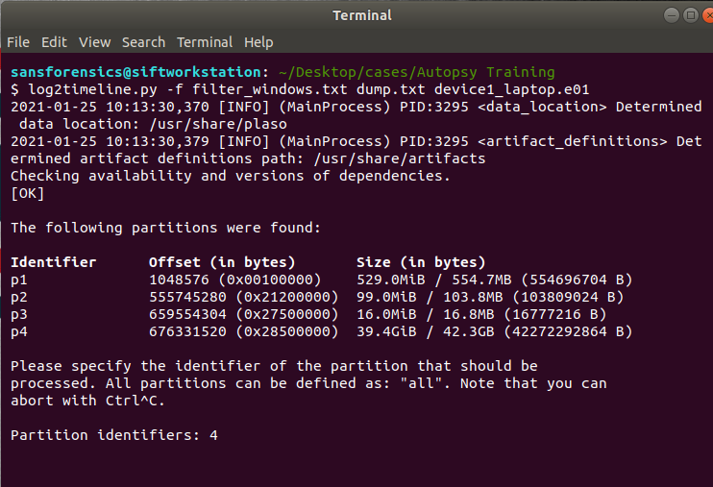
Use Plaso to Create Memory Dump
First step is to create a memory dump of the image to be processed later by pysort
Command Line Arguments
-f : specify the filter file name
Command format
Log2timeline.py [-f filter] <output file> <input file>
Select disk partition 4 since it has the largest size hence likely to be active boot sector

Slide 52
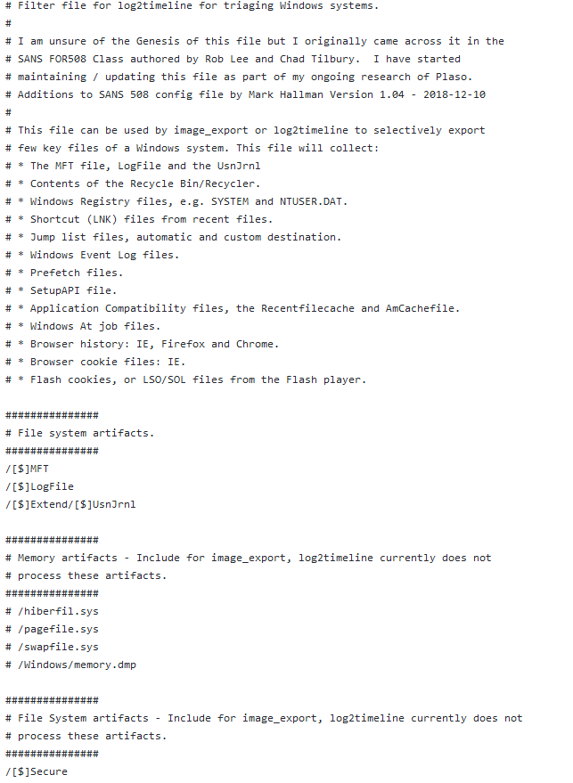

Use Plaso to Create Memory Dump
Filter file is available for download from the github repo below

Slide 53

Plaso pinfo.py
We can use pinfo.py to get various information about the dump file
Events per parser, partition and OS information for each partition can be displayed

Slide 54

Plaso pinfo.py results

Slide 55



Plaso psort.py
Allows us to filter events by date and time
Can leverage timeline generated in Autopsy to conduct effective filtering
Command line arguments
-z : timezone (Fis should pick UTC)
-o : output format (can be l2tcsv or xlsx)
-w : file to write to
--slice : specify slice of time
Other filters like date ranges

Slide 56

Viewing timeline.csv in Timeline Explorer
Download Timeline Explorer by Eric Zimmermann’s Github in the Windows 10 VM
Export the timeline.csv from the SANS SIFT workstation to the Windows 10 VM

Slide 57


Filtering events in Timeline Explorer
Timeline Explorer allows filtering of events—based on Source Name and Timestamp
Allows the FIs to corelate events leading up to the crime

Slide 58
Thank You

